Slide 1
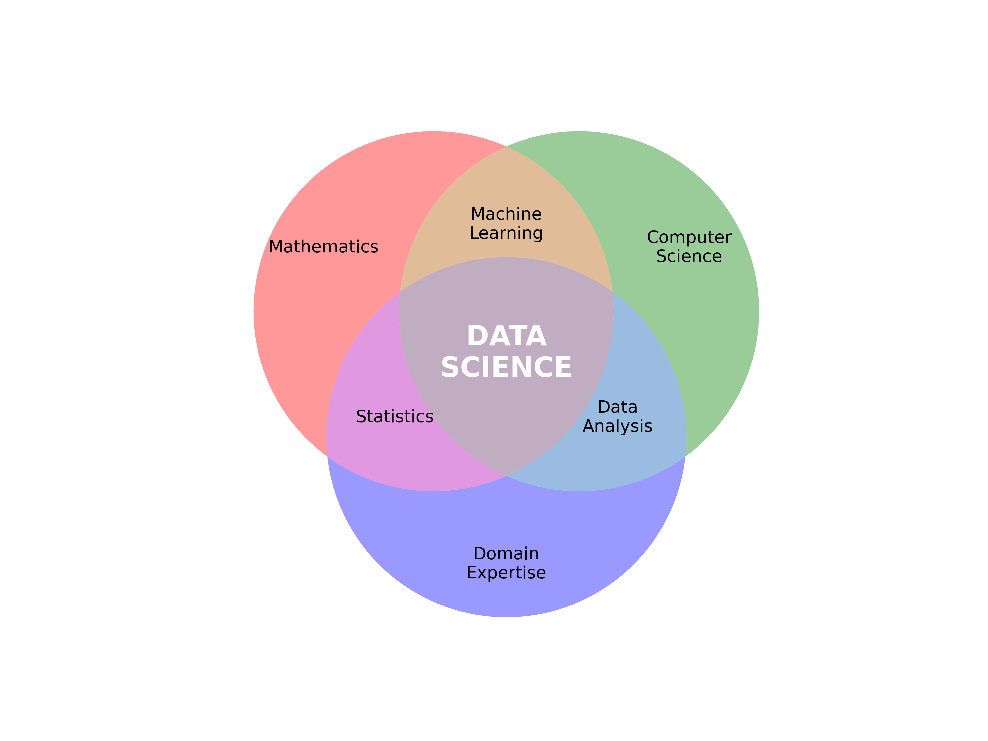
Introduction to Data Science
Immerse Education Tokyo 2025
Innovation

Slide 2
Course Overview
At the end of this course:
Understand what data science is and how it influences the world around us.
Be familiar with common terms and ideas used in data science.
Be able to design and build a simple data science pipeline.
Be familiar with Python and how it’s used in data science.
Be familiar with the type of mathematics that’s used in data science.
Have an idea of what is meant by a machine learning model and know how to implement a simple model in Python.

Slide 3
What is Data Science?
Biomedical
Engineering

Slide 4
What is data?
Data is a collection of facts, numbers, words, observations or other useful information. – Technical Writers at IBM
facts – something considered to be objectively true. e.g. the human heart has 4 chambers (domain knowledge)
numbers – numerical measurements. e.g. heart rate, age, acceleration, speed
words – text that carries meaning. e.g. responses to surveys, categorical labels (eye colour – “green”, “brown”, “blue”)
observations – anything (including numbers and words) recorded at a specific instance. e.g. heart rate at 10:30 am
useful information – anything we can measure, or record in some way can be considered data
“collection” – something that has been gathered together by someone. Very important! Sampling bias!

Slide 5
Quantitative Data
Qualitative Data
Numerical
Descriptive, non-numerical
Discrete or Continuous
Ideal for processing with algorithms
More difficult to process automatically
Qualitative data can often be processed into quantitative data
but information is usually lost in the process

Slide 6
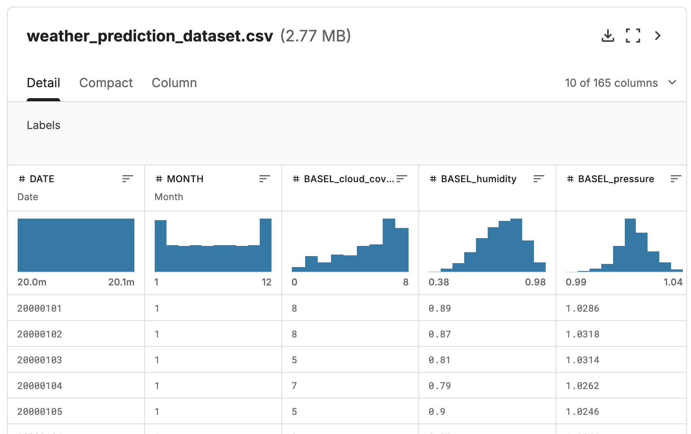
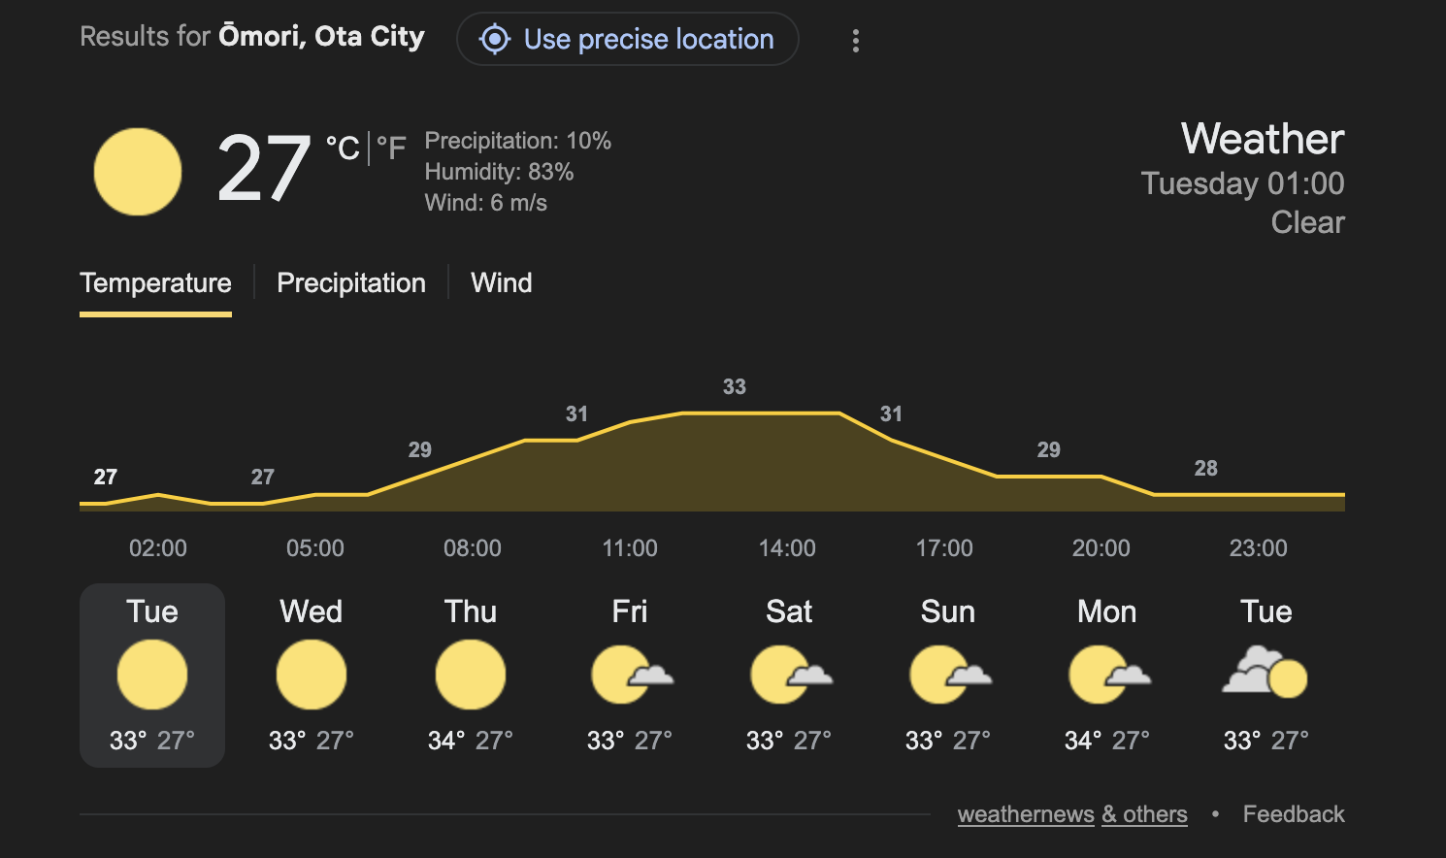
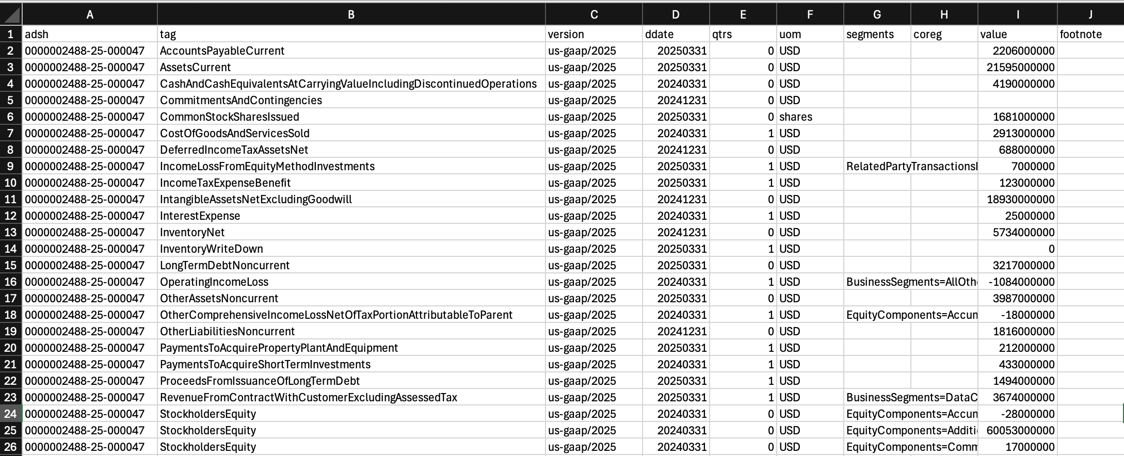
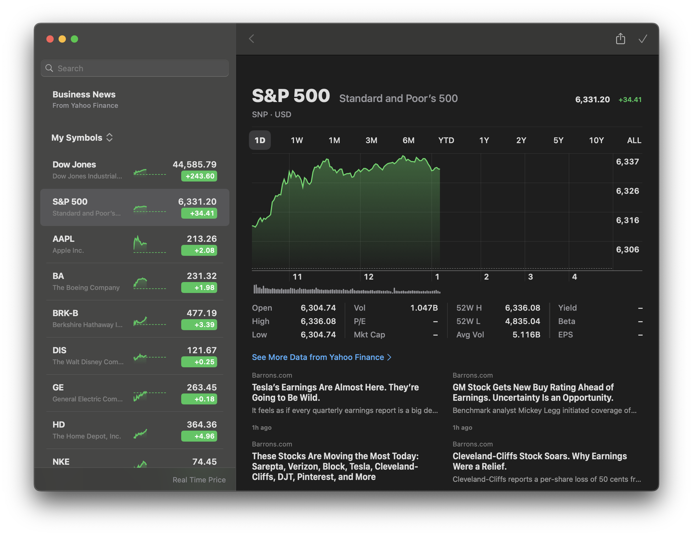
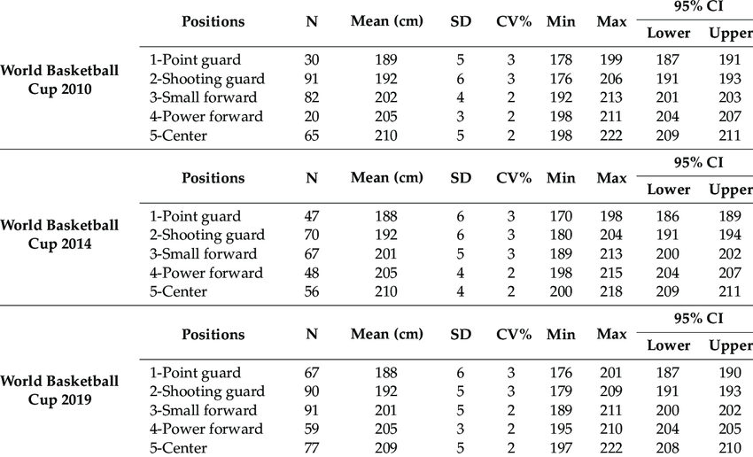
Examples of Data
Financial Data
Weather Data
Statistical Data (Height Measurements)

Slide 7
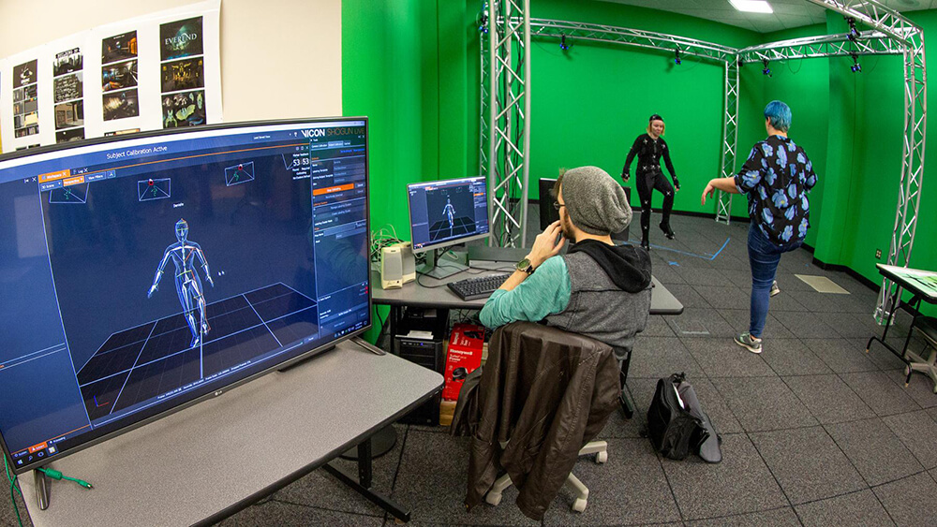
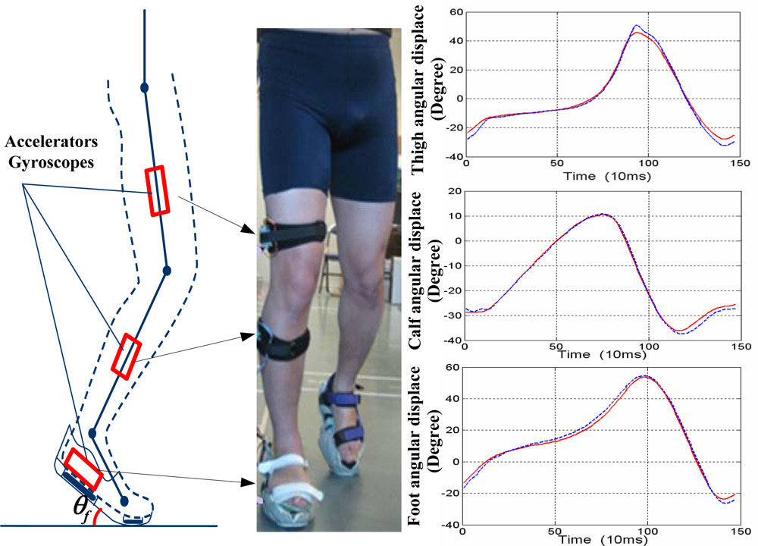
Examples of Biomedical Data Collection

Slide 8
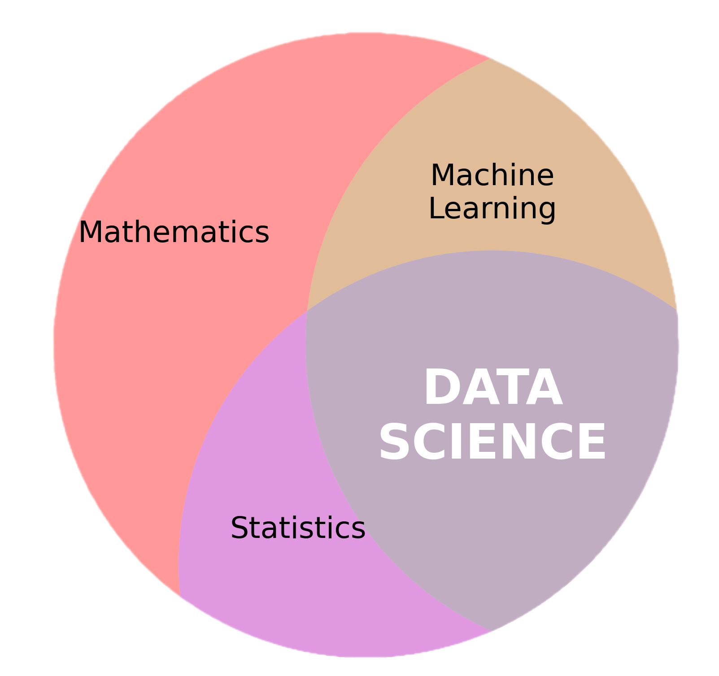
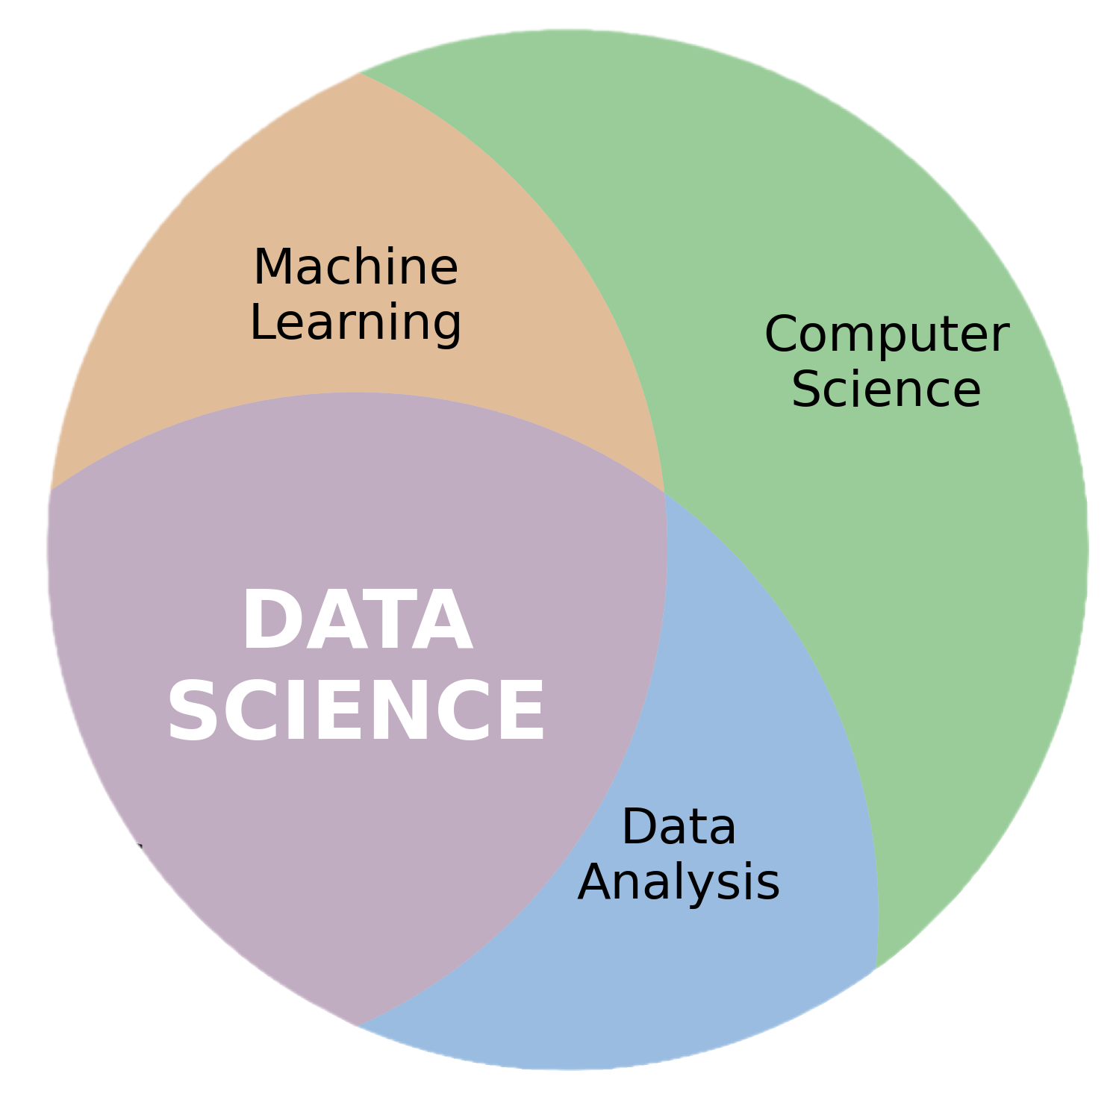
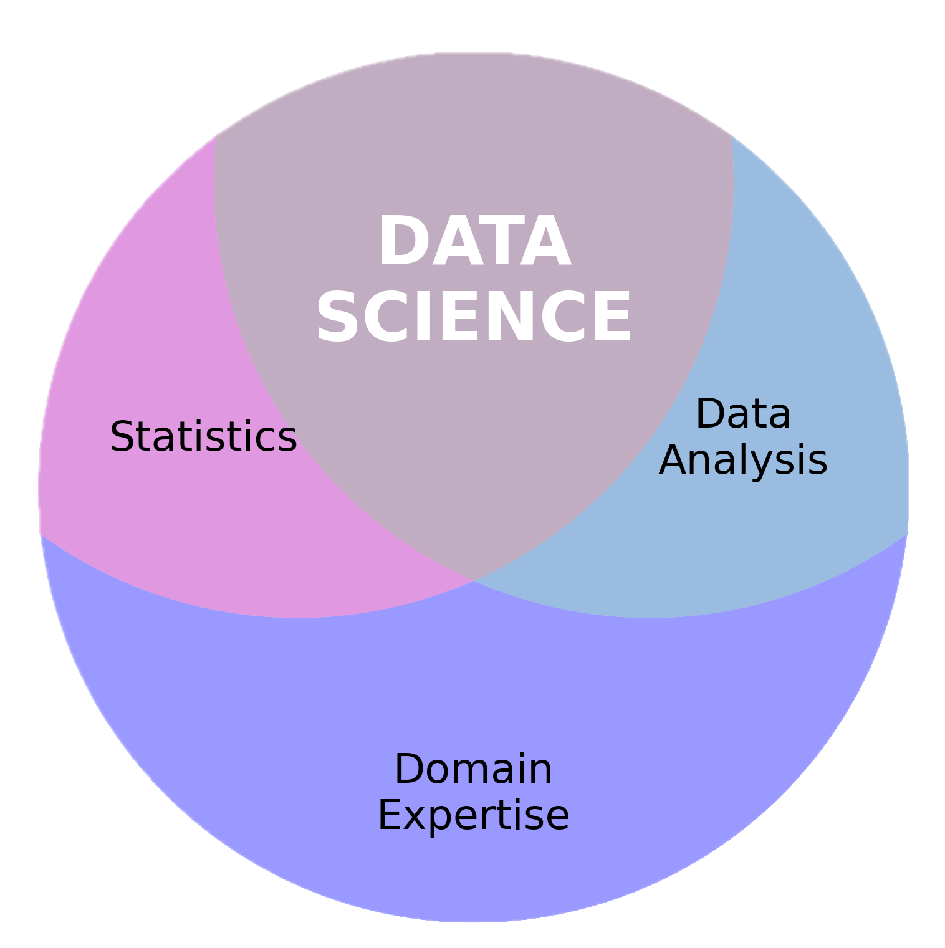
What is Data Science?
analysing
organizing
collecting
Data science is the process of collecting, organizing, and analysing data to find useful information, make decisions, or solve problems.

Slide 9

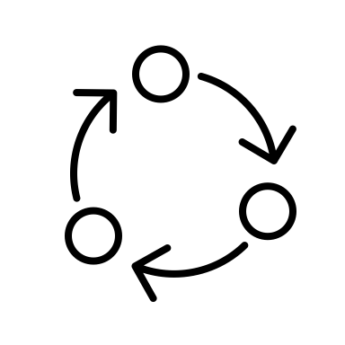

What is Data Science?

Slide 10
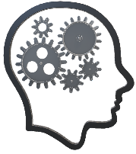
Exercise: Algorithms and Data Science
Have you heard the word “algorithm”?
Or about “The Algorithm” when using social media?
Think of some ways in which data science influences your life.

Slide 11
Data Science Workflow
Problem
Plan
Data
Analysis
Conclusion
Understanding and defining the problem
What to measure and how?
Collection, management, cleaning
Perform statistical analysis
Construct machine learning models
Interpretation and conclusion
Communication of results/ deployment of models
Study design
Definitions
PPDAC

Slide 12
Problem
What kinds of problems can data science solve?
Ask these questions
Is there data available? Is there something we can measure?
Is there some kind of pattern or relationship that we are looking for or that we can use?
There is something we need to classify or predict.

Slide 13
Problem
What kinds of problems can data science solve?
Healthcare | Finance | Environmental Science
Disease diagnosis Medical image analysis Hospital mortality prediction Biomechanical analysis | Stock market prediction Credit card fraud detection Loan approvals | Water usage prediction Power grid optimization Climate modelling Wildfire detection/prediction

Slide 14
Research Question
What do we need to measure?
(Variables)
How much do we need to measure?
(Sample Size)
How do we measure what we need to?
(Collection Methods)
How will we analyse the data?
(Data Analysis)
Plan

Slide 15
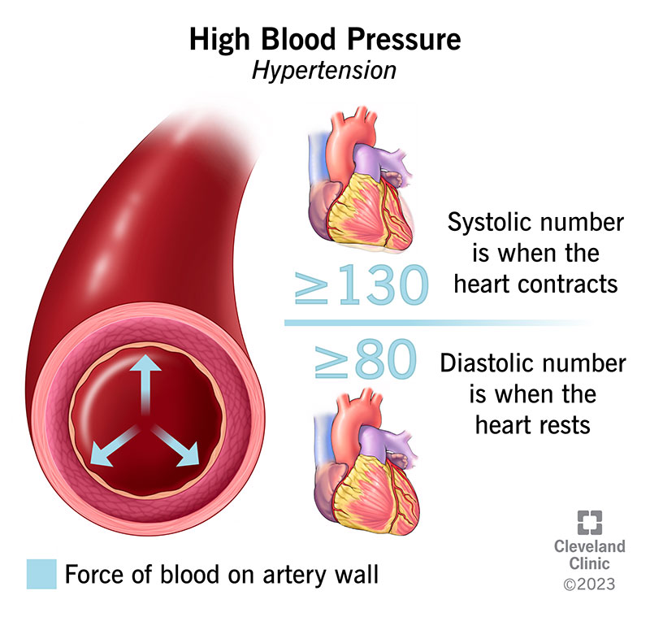
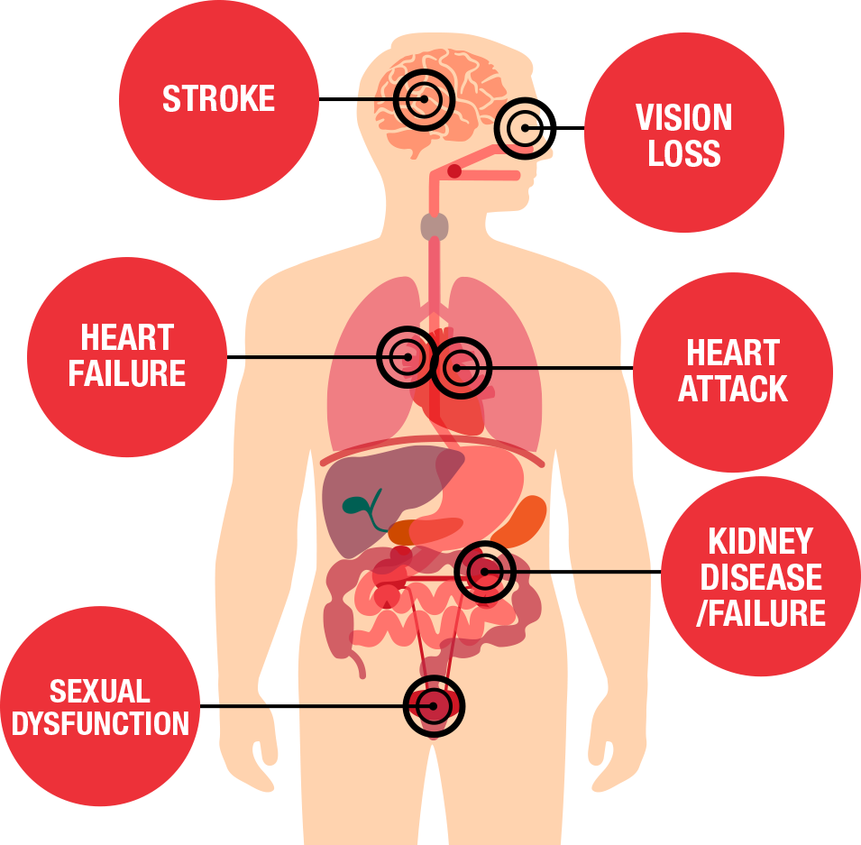
Research Question
What do we need to measure?
(Variables)
How much do we need to measure?
(Sample Size)
How do we measure what we need to?
(Collection Methods)
How will we analyse the data?
(Data Analysis)
Problem: High blood pressure has many health risks. Some people may be more susceptible to developing high blood pressure than others.
To what extent can we predict the development of high blood pressure?

Slide 16
Research Question
What do we need to measure?
(Variables)
How much do we need to measure?
(Sample Size)
How do we measure what we need to?
(Collection Methods)
How will we analyse the data?
(Data Analysis)
To what extent can we predict the development of high blood pressure (hypertension)?
Very tricky!
What’s the “population” size?
Proof-of-concept study
Acceptable margin-of-error
Resource constraints
Research partners
Outcome variable: hypertension?
Input variables:
Demographic (gender, age, etc.)
Lifestyle (Behavioral)
Sensor (Biometric)
What do we need to measure?
(Variables)
How much do we need to measure?
(Sample Size)
Study protocol
Development of disease, so longitudinal (over time)
Collect data at home or just during a visit?
Survey design
Recording devices
Important to have an idea of what kind of analysis we should perform beforehand.
Avoid “cherry picking” or running different analyses to match our expectations
How do we measure what we need to?
(Collection Methods)
How will we analyse the data?
(Data Analysis)

Slide 17
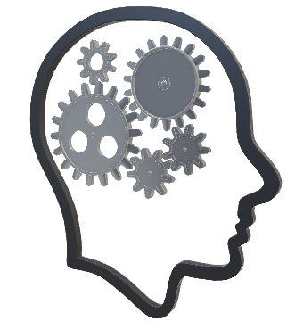
Your turn!
Pick a problem domain e.g., healthcare, transport, environmental
Think of a problem in this domain you’d like to solve
Come up with a research question that would help solve this problem
Now plan what data we need to collect and how we’ll go about collecting it.

Slide 18
Summary
Two important definitions from this presentation:
Data is a collection of facts, numbers, words, observations or other useful information.
Data science is the process of collecting, organizing, and analysing data to find useful information, make decisions, or solve problems.

Slide 19
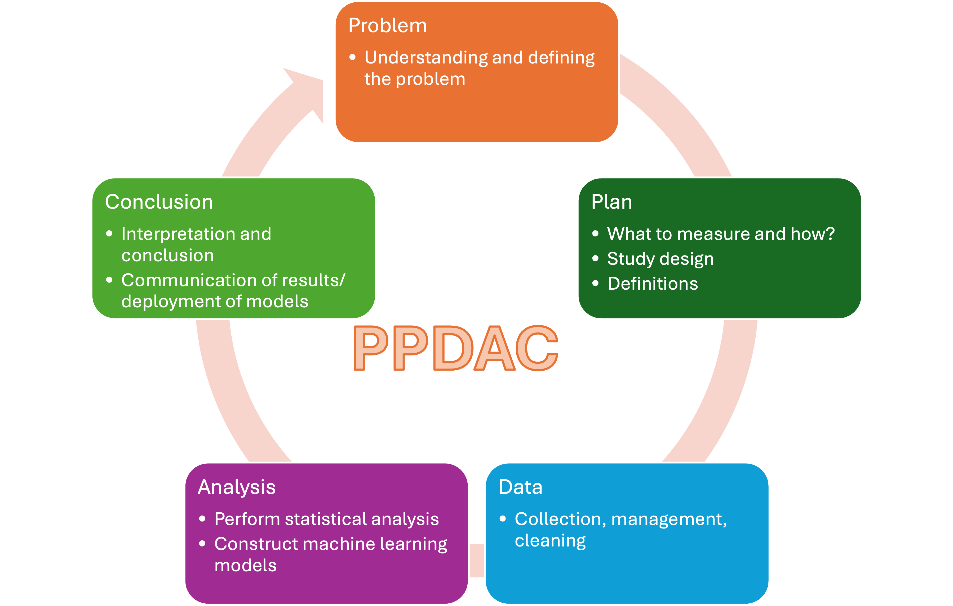
Preview
This afternoon we’ll set up Python on your laptops and get started with some basic Python programming.
We’ll also start thinking about your ”personal projects” for the next two weeks.
Tomorrow during the 1:1’s everyone should decide on a personal project
Next week we’ll talk more about “Data Science Pipelines”
This will cover the Data, Analysis, and Conclusion parts of the PPDAC

